Slide 1
Designing of Non-Invasive Blood Pressure Measuring Devices
By : yogeshwar prasad lohiya (180107074)
Guide : Prof. dipankar bandyopadhyay
prof. resmi suresh

Slide 2
Content
Recap of previous meeting
Analysis of non-invasive bp measurement techniques
Pulse wave analysis
Photoplethysmography (PPG)
Electrocardiogram (ECG)
Pulse transition time (PTT)
Biosensor module

Slide 3
Recap
Blood pressure : Pressure exerted by the blood against the walls of blood vessels. Arterial and Venous BP.
Types of BP : Systolic (when heart beats) and Diastolic (when heart is in rest b/w two beats) BP.
Importance of measuring BP. Stages of BP (Normal, Elevated, Stage-1 hypertension, Stage-2 hypertension, Hypertensive crisis, Hypotension).
Hypertension V/s Hypotension : Definition, Symptoms, Causes, Risk factors, Prevention.
Ways of measuring BP : Invasive (directly by inserting cannula needle in suitable artery).
Non-Invasive (by applying counter pressure to keep blood volume constant).
Invasive V/s Non-Invasive BP measurement : Equipment, Process of measurement, Advantages, Disadvantages.
Positional variations in BP measurement : when measured while laying down, it’s lower than when measured while sitting. When standing it’s lowest because of gravity, amount of blood returning back to heart becomes lower. Thus decrease in stroke volume and BP.

Slide 4
Recap
Arm V/s Wrist V/s Finger BP
Indirect BP measurement techniques :
Palpatery method Flush method
Ultra-Sound method Oscillometric method
Auscultatory method Vasculor unloading technique
Tonometry Pulse transist time
Available portable BP measuring devices
Omron Heart Guide : Uses oscillometric method to obtain BP estimate
Asus VivoWatch BP (HC-A04) : Uses ECG and PPG sensors to obtain PTT and then BP estimate.

Slide 5
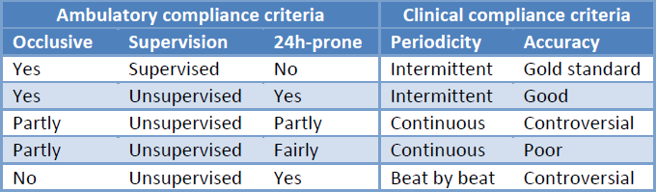
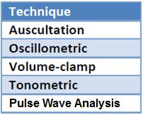
Analysis of non-invasive techniques for BP measurement
The analysis can be done based on : Ambulatory compliance criteria ; Clinical compliance criteria
Ambulatory compliance criteria :
1. Does a measurement require the full occlusion of the arterial flow of blood ?
2. Is human supervision required ? 3. 24 hour monitoring possible ?
Clinical compliance criteria :
1. Continuous / Intermittent / Beat by Beat ? 2. Accuracy ? when compared against arterial catheter measurement
Source : https://doi.org/10.3929/ethz-a-007273889

Slide 6
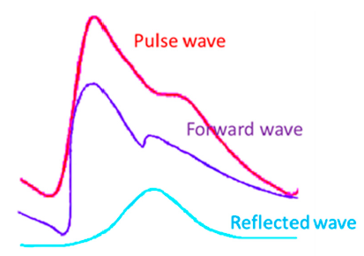
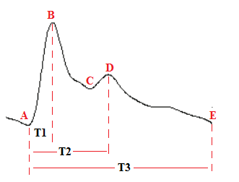
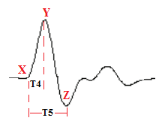
Pulse Wave Analysis
Pulse wave : Pressure wave that travels along the arterial tree.
Formed from the combination of incident wave and reflected wave from periphery.
Pulse wave :
A : Minimum volume during diastolic cycle; B : Maximum volume during systolic cycle
C : Dicrotic notch; D : Dicrotic valve amplitude; T1 : Crest time; T2 : Dicrotic wave time
T3 : Total pulsation time
Differential pulse wave :
X : Volume change at the beginning of systolic cycle
Y : Maximum volume change during systolic cycle
Z : Minimum volume change during diastolic cycle
Source : https://www.mdpi.com/2076-3417/9/14/2922/htm

Slide 7
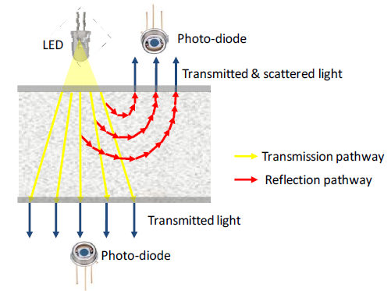
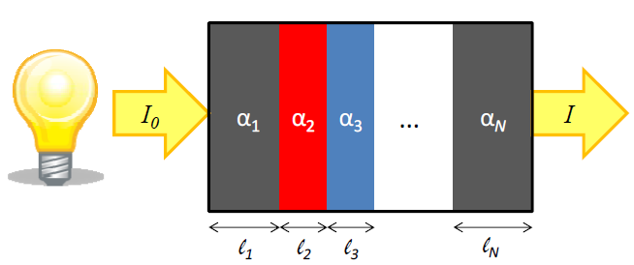
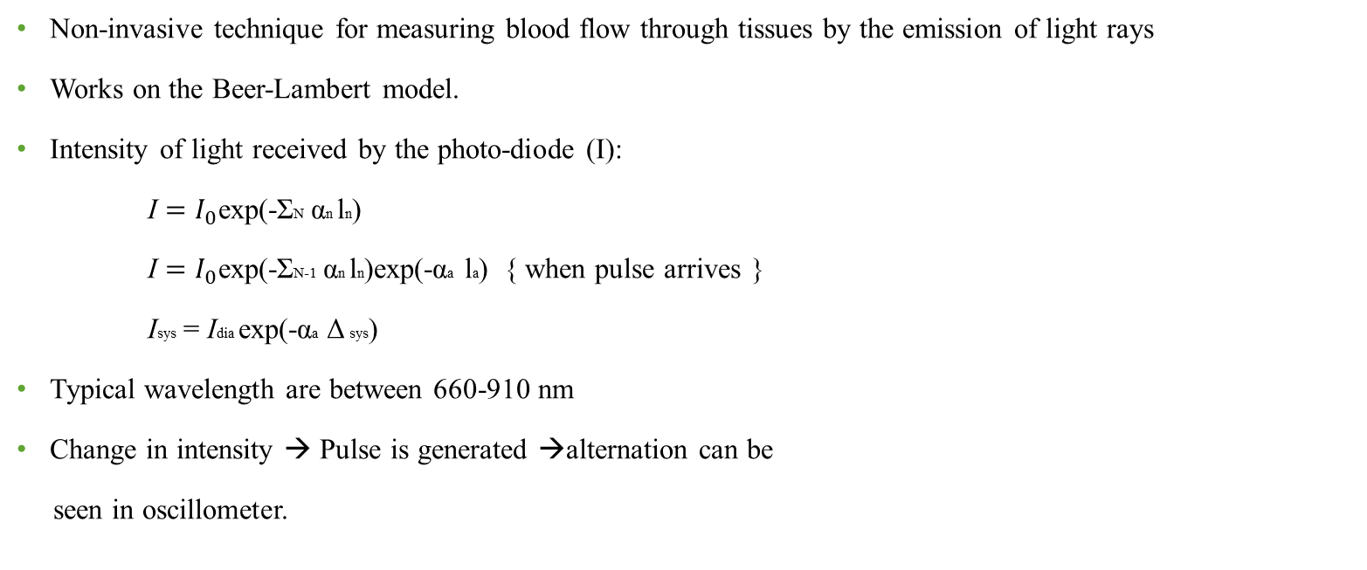
PPG
Non-invasive technique for measuring blood flow through tissues by the emission of light rays
Works on the Beer-Lambert model.
Intensity of light received by the photo-diode (I):
I $=I_{0}$exp(-ΣN αn ln)
I $=I_{0}$exp(-ΣN-1 αn ln)exp(-αa la) { when pulse arrives }
Isys = Idia exp(-αa Δ sys)
Typical wavelength are between 660-910 nm
Change in intensity → Pulse is generated →alternation can be
seen in oscillometer.
Source : https://doi.org/10.3929/ethz-a-007273889

Slide 8

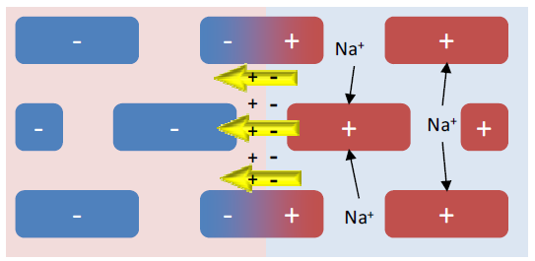
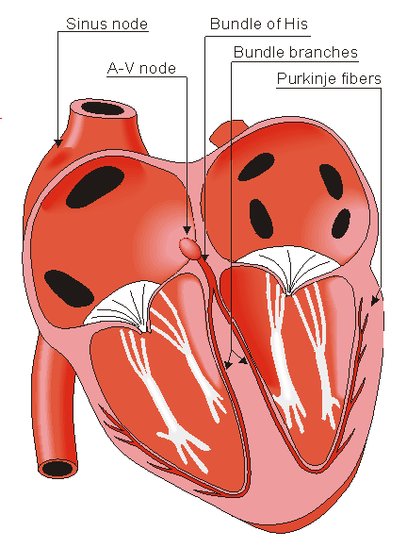
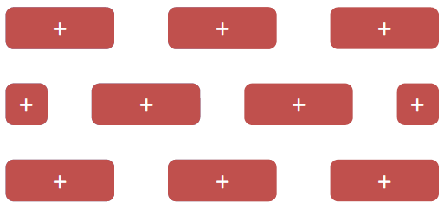
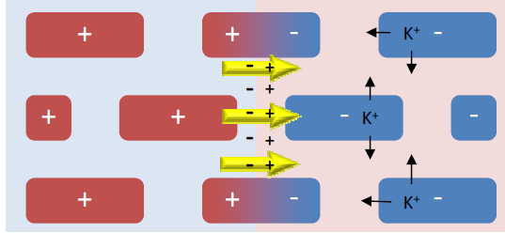
ECG (Electrocardiogram)
ECG records electrical signals that are generated in the heart during the cardiac cycle.
Source : https://doi.org/10.3929/ethz-a-007273889

Slide 9
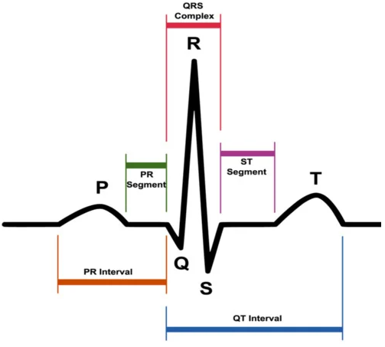
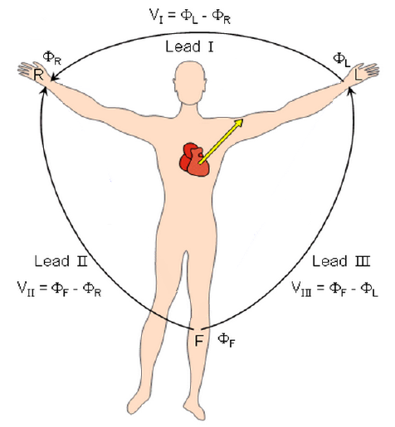
ECG signal
https://www.mdpi.com/2079-9292/9/6/951/htm
Source : https://doi.org/10.3929/ethz-a-007273889

Slide 10
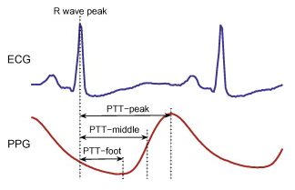
PTT
Time required for the arterial pulse pressure wave to propagate from the aortic valve to a peripheral site.
PTT is the time period from R wave peak of ECG to a characteristic point of PPG
Higher the blood pressure → Stiffer the arterial wall → Higher the pulse wave velocity → lower the PTT
Use pulse wave parameters (Heart rate, volume change during systolic and diastolic cycle etc.) along with PTT to get better estimate

Slide 11
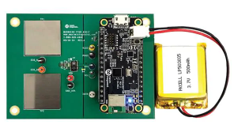
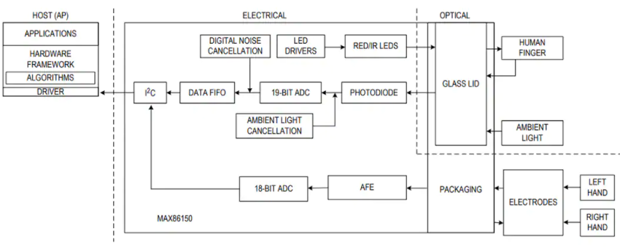
Maxim Integrated MAX86150 Bio-Sensor Module
Both Photoplethysmogram (PPG) and Electrocardiogram (ECG) measurements in a single integrated package.

Slide 12
Thank You !!

